Slide 1
STIs & Youth
Teaching Kids and Teens about Sexual Health and STI Prevention
By
Noelle Bates, MD, MPH

Slide 2
Syphilis
Caused by the bacteria Tryponema pallidum
Transmitted by direct contact with a syphilitic sore, known as a chancre.
Has different stages, and if not treated properly or early on, can have significant consequences as it advances through each stage
Notes:
Transmission: Chancres can occur on or around the external genitals, in the vagina, around the anus , or in the rectum, or in or around the mouth. Transmission of syphilis can occur during vaginal, anal, or oral sex. In addition, pregnant women with syphilis can transmit the infection to their unborn child.
Chancres can occur on or around the external genitals, in the vagina, around the anus , or in the rectum, or in or around the mouth. Transmission of syphilis can occur during vaginal, anal, or oral sex. In addition, pregnant women with syphilis can transmit the infection to their unborn child.

Slide 3
Primary: Single chancre, which is typically firm, round, and painless
Secondary: Skin rash
Latent: No visible signs or symptoms
Tertiary: 10-30 years after; can be fatal, and symptoms are system dependent
Notes:
1:appearance of a single chancre marks the primary (first) stage of syphilis symptoms, but there may be multiple sores. The chancre is usually (but not always) firm, round, and painless. It appears at the location where syphilis entered the body. These painless chancres can occur in locations that make them difficult to notice (e.g., the vagina or anus). The chancre lasts 3 to 6 weeks and heals regardless of whether a person is treated or not. However, if the infected person does not receive adequate treatment, the infection progresses to the secondary stage.
2: Skin rashes and/or mucous membrane lesions (sores in the mouth, vagina, or anus) mark the second stage of symptoms. This stage typically starts with the development of a rash on one or more areas of the body. Rashes associated with secondary syphilis can appear when the primary chancre is healing or several weeks after the chancre has healed. The rash usually does not cause itching. The characteristic rash of secondary syphilis may appear as rough, red, or reddish brown spots both on the palms of the hands and the bottoms of the feet. However, rashes with a different appearance may occur on other parts of the body, sometimes resembling rashes caused by other diseases. Sometimes rashes associated with secondary syphilis are so faint that they are not noticed. Large, raised, gray or white lesions, known as condyloma lata, may develop in warm, moist areas such as the mouth, underarm or groin region. In addition to rashes, symptoms of secondary syphilis may include fever, swollen lymph glands, sore throat, patchy hair loss, headaches, weight loss, muscle aches, and fatigue. The symptoms of secondary syphilis will go away with or without treatment. However, without treatment, the infection will progress to the latent and possibly tertiary stage of disease.
Latent: The latent (hidden) stage of syphilis is a period of time when there are no visible signs or symptoms of syphilis. Without treatment, the infected person will continue to have syphilis in their body even though there are no signs or symptoms. Early latent syphilis is latent syphilis where infection occurred within the past 12 months. Late latent syphilis is latent syphilis where infection occurred more than 12 months ago. Latent syphilis can last for years.
Tertiary: Tertiary syphilis is rare and develops in a subset of untreated syphilis infections;, it can appear 10–30 years after infection was first acquired, and it can be fatal. Tertiary syphilis can affect multiple organ systems, including the brain, nerves, eyes, heart, blood vessels, liver, bones, and joints. Symptoms of tertiary syphilis vary depending on the organ system affected.

Slide 4
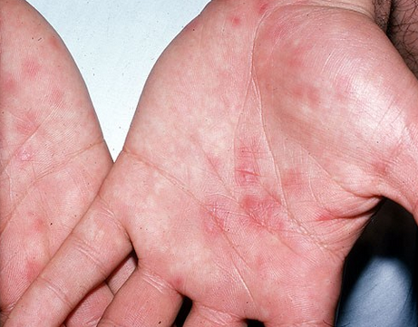
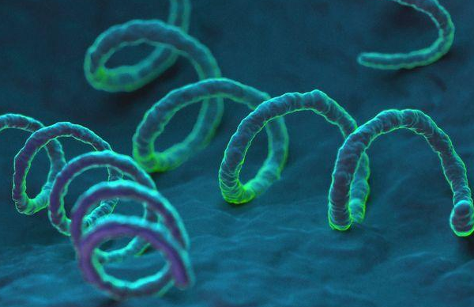

Slide 5
How is it spread?
Receptive fellatio
Insertive fellatio
Receptive cunnilingus
Insertive cunnilingus
Anal receptive sex
Anal insertive sex
Penile-vaginal sex
Notes:
In the United States, approximately half of men who have sex with men (MSM) with primary and secondary (P&S) syphilis were also living with HIV.² In addition, MSM who are HIV-negative and diagnosed with P&S syphilis are more likely to be infected with HIV in the future. ⁶ Genital sores caused by syphilis make it easier to transmit and acquire HIV infection sexually. There is an estimated 2- to 5-fold increased risk of acquiring HIV if exposed to that infection when syphilis is present. ⁷ Furthermore, syphilis and certain other STDs might be indicators of ongoing behaviors and exposures that place a person at greater risk for acquiring HIV.

Slide 6
Treatment
Primary: Benzathine penicillin G 2.4 million U IM for 1 dose
Latent: Benzathine penicillin G 7.2 million U, divided as 3 separate IM shots of 2.4 million U, one per week
Neurosyphilis: penicillin G 18-24 million U per day, administered as 3-4 million U IV every 4 hours for 10-14 days
Notes:
The recommended treatment for adults and adolescents with primary, secondary, or early latent syphilis is Benzathine penicillin G 2.4 million units administered intramuscularly in a single dose. The recommended treatment for adults and adolescents with late latent syphilis or latent syphilis of unknown duration is Benzathine penicillin G 7.2 million units total, administered as 3 doses of 2.4 million units administered intramuscularly each at weekly intervals. The recommended treatment for neurosyphilis and ocular syphilis is Acqueous crystalline penicillin G 18-24 million units per day, administered as 3-4 million units intravenously every 4 hours or continuous infusion, for 10-14 days. Treatment will prevent disease progression, but it might not repair damage already done.

Slide 7
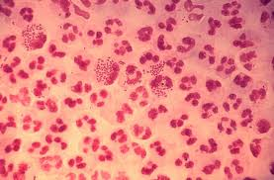
Gonorrhea
Like syphilis, this is caused by a bacterium. That is good news because antibiotics can treat most strains of gonorrhea. You are seeing diplococci bacteria.

Slide 8
What is it?
Unlike syphilis – which creates an ulcer anywhere is penetrates the skin, gonorrhea is a urethral infection (meaning that is grows in the urinary tract) and it also “likes” moist mucous membranes, such as rectum, vagina, and mouth.

Slide 9
What are the specifics?
Usually asymptomatic in females (80%) and rarely asymptomatic in males – this is also true with other STIs and is known as biological sexism.

Slide 10
Symptoms: Males
Vary painful urination if infected in the urinary tract.
Pus-like discharge

Slide 11
Gonococcal urethritis

Slide 12
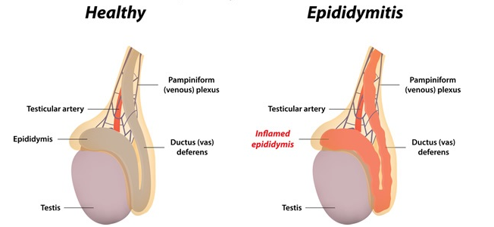
Epididymitis
Notes:
This an inflammation of the tissue that creates sperm.

Slide 13
In females…
Greenish – yellow vaginal discharge
Lower abdominal pain
Dysuria (painful urination)
Pelvic Inflammatory Disease (PID)

Slide 14
What is PID?
This is an inflammation of the cervix, uterus, fallopian tubes, and ovaries – it is extremely painful (often leading to hospitalization) and is a common cause of infertility.
Infertility – female cannot reproduce
Sterility – male cannot reproduce

Slide 15
PID

Slide 16
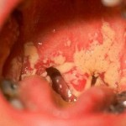
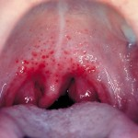
Oral gonorrhea

Slide 17
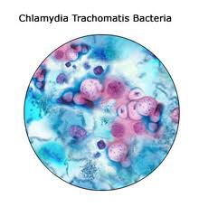
Chlamydia
Much like gonorrhea, Chlamydia can infect moist mucus membranes and it has a proclivity for the urinary tract.

Slide 18
How is it spread?
Receptive fellatio
Insertive fellatio
Receptive cunnilingus
Insertive cunnilingus
Anal receptive sex
Anal insertive sex
Penile-vaginal sex

Slide 19
Often called non-gonococal urethritis (NGU) when the urinary tract is infected
Primary cause of PID
Symptoms are similar (often indistinguishable) to symptoms of gonorrhea, except fever and flu-like symptoms may be present
75% of females are asymptomatic (50% males)
Most common among teen females because of cervical ectopy.

Slide 20
Chlamydia cervicitis

Slide 21
Treatment
Gonorrhea:
Ceftriaxone 250 mg IM single dose
+
1g azithromycin PO single dose
Chlamydia:
Doxycycline 100 mg PO BID for 7 days
OR
1g azithromycin PO single dose

Slide 22
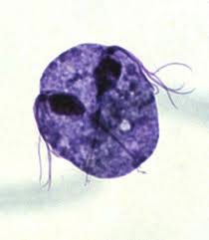
Trichomoniasis
T. Vaginalis is a parasite, not a bacteria. It has a flagella.

Slide 23
What is it?
The parasite causes a frothy yellow-green discharge in females and a strong (bad) odor. Vaginal irritation and mild pain during urination may occur. Men rarely have symptoms or problems.

Slide 24
How is it spread?
Sex between women
Penile-vaginal sex

Slide 26
Now, a viral STI: Herpes
This one is complicated.
Herpes simplex virus type 1 (mostly oral)
Herpes simplex virus type 2 (mostly genital)

Slide 28
Stages
Acute (new also called primary) infection – fever, flu-like symptoms, vesicles form
Subsequent outbreaks become progressively less severe but they can occur at any time for the rest of the person’s life.
Person will always shed virus – always contagious

Slide 30
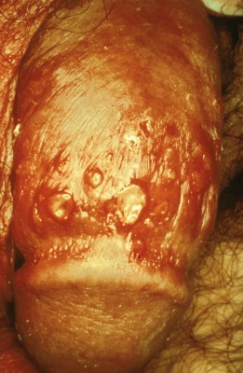
Primary herpes, male

Slide 31
HPV
Group of over 150 related viruses, implicated in genital warts, but more worrisome, cancer
Cervical cancer: Virtually all cases of cervical cancer are caused by HPV, and just two HPV types, 16 and 18, are responsible for about 70% of all cases.
Anal cancer: About 95% of anal cancers are caused by HPV. Most of these are caused by HPV type 16.
Oropharyngeal cancers (cancers of the middle part of the throat, including the soft palate, the base of the tongue, and the tonsils): About 70% of oropharyngeal cancers are caused by HPV. In the US, more than half of cancers diagnosed in the oropharynx are linked to HPV type 16.
Rarer cancers: HPV causes about 65% of vaginal cancers, 50% of vulvar cancers, and 35% of penile cancers. Most of these are caused by HPV type 16.
Notes:
Each virus is given a number to delineate what type

Slide 32
HPV vaccination before sexual activity can reduce the risk of infection by the HPV types targeted by the vaccine.
Recommended range is vaccinating between 9 and 26 years old
There are three FDA approvedvaccines to prevent HPV infection: Gardasil®, Gardasil® 9, and Cervarix®. These vaccines provide strong protection against new HPV infections, but they are not effective at treating established HPV infections or disease caused by HPV.
Correct and consistent condom use is associated with reduced HPV transmission between sexual partners.
Notes:
However, because areas not covered by a condom can be infected by the virus, condoms are unlikely to provide complete protection against the infection.

Slide 33
Challenges of teaching sex education

Slide 34
Audience
What age group are you teaching?
Elementary school children: ensuring they understand the facts in a meaningful way
Adolescents
Notes:
Adolescents:
-Being taken seriously. Do they already have preformed ideas?
-Do they “know more”?

Slide 38
Defining Sex
In Misclassification bias: diversity in conceptualizations about having ‘had sex’ by Sanders et al, nearly 95 percent of people agreed that penile-vaginal intercourse meant "had sex."
11 percent of respondents would not use the phrase "had sex" if "the man did not come." About 80 percent said penile-anal intercourse meant "had sex.”
About 70 percent of people believed oral sex was sex.
Notes:
How are children and adolescents defining sex? How are you?
Those numbers changed as the questions got more specific.

Slide 39
Mississippi Law
HB 999 prohibits the following:
1. Condom demonstrations
2. Discussion of abortion as a means to prevent the birth of a baby
3. Co-ed sex education lectures

Slide 40
School districts must understand and comply with the requirements of the CHART Initiative, the PREP grant, and House Bill 999, Mississippi’s sex education law.
Creating Healthy and Responsible Teens (CHART): Initiative was created by Mississippi First in conjunction with the Mississippi State Department of Health to reduce teen pregnancy, improve teen sexual health, and increase responsible decision-making
Works with Mississippi school districts to increase adoption and implementation of comprehensive or “abstinence-plus” sex education policies and evidence-based, medically accurate, and age-appropriate programs.
The Personal Responsibility Education Program (PREP) grant is a federal grant received by the Mississippi State Department of Health to support teen pregnancy prevention efforts in Mississippi public schools and communities.

Slide 41
Challenges
Subject matter
Does your audience understand you?
Does your audience TRUST you?
Do you have certain parameters within which you have to work?

Slide 42
Think outside the box….
Notes:
“Non-condom” demonstration

Slide 43
Questions?
Thank you!

