Slide 1
PREPARING FOR GRADUATION
Class of 2019

Slide 2
Graduation Requirements
In order to graduate, you must:
Complete and log in E*Value the required technical skills
Complete courses in the ambulatory, pediatrics, and surgery cores, along with MED 651, Senior Seminar, and at least four (4) electives. We will contact you if you are missing a requirement
Obtain passing scores on both Step II CK and CS

Slide 3
Upcoming Events
Rank Order List – Opens January 15th at 11:00 am CT, closes February 20nd at 8:00 pm – will discuss in detail later
Match Week – March 11-15th
Match Day – Friday, March 15th
Honors Day – Friday, May 6th
Long Coat Ceremony – Thursday, May 23rd
Commencement – Friday, May 24th

Slide 4
Match Week
Friday, March 8th – you’ll receive an email from the NRMP verifying your eligibility for SOAP. This doesn’t mean that you did not match.
Monday, March 11th, 11:30 am – you can learn whether you matched by logging in to the NRMP R3 System and checking your Match Home page. If you are unmatched or partially matched, you’ll need to come to SM001-01 by 12:00 noon for SOAP. More information about SOAP shortly
Friday, March 15th – The Match Day Ceremony will begin at 11:00 am. Match results will be posted in the NRMP R3 System at 12:00 noon

Slide 5
Match Day
Alumni Breakfast –may bring a guest
Ceremony at Thalia Mara Hall. Doors open at 10:00 am. Ceremony begins at 11:00 am and usually ends by 12:30 pm. You may invite as many guests as you’d like!
The ceremony begins with a few speeches, then students come on stage, one by one, to receive results and announce them to the audience. Each student draws a name of the next student called up. The last student wins a medical bag with $$$!

Slide 6
To Do’s Before Graduation
Must complete an exit interview with the Financial Aid office
Must clear account with the library and the Registrar’s office
Must clean out and take locks off any campus lockers
If you match outside of UMMC, must go to the VA to clear your VA account. Scheduling information will be sent from Dr. Clark’s office

Slide 7
Honors Day
Friday, May 3rd at 12:00 noon
Will be held upstairs at the Student Union
You will be notified by email if you are receiving an award
Professional attire

Slide 8
Long Coat Ceremony
Ceremony on Thursday evening, May 23rd
Held at the Jackson Convention Center
Class officers will communicate details
Go to Student Affairs beginning February 1st to pick style/size for long coat and how you want your name to read

Slide 9
Commencement – Cap & Gown Instructions
The deadline for completing your online registration for graduation is coming up!
Pick up cap and gown in the ASB office of the Student Union on Thursday morning, May 23rd. Try cap on while there to make sure it fits!
Hang gown on the back of the bathroom door overnight to steam
Pin card that comes with the gown to the inside of the gown for easy return

Slide 10
Commencement - Ceremony Instructions
Friday, May 24th – 10:00 am at the Jackson Coliseum
Arrive between 8:30 - 9:00 am. Line up begins at 9:00 am
Professional attire
Men – Dress shirt and tie, no coat
Women – Dark shoes, no sandals or high heels
More details as the date gets closer

Slide 11
Medical Licensure
If you match in MS - you will receive info from the Office of Graduate Med. Education (GME) about how to apply for restricted temporary licensure with the MS Board of Licensure. The Registrar’s office will take care of sending a copy of your diploma, transcript and complete Appendix A. You will send in everything else
If you match outside of MS - you will receive info. from your program or the state licensing agency about how to apply for licensure in your new state. Included will be forms that you will need to bring to the Registrar’s office for your transcript and graduation certification
All graduation certifications from the Registrar’s office will be sent out the morning of graduation, not before

Slide 12
Medical Licensure
Even with a restricted license as a trainee, you will be responsible for how you conduct yourself.
Guard your medical license and your reputation!
Once you DO get the authority and a DEA number to write for controlled substances, DO NOT misuse your power to do so. Follow the rules carefully about controlled substances. These are tracked.
YOU will be responsible for keeping your license up to date.
You CAN lose your license for unprofessional and/or unethical behavior.
People will see you as a physician 24/7 no matter what you are doing.
You CANNOT practice medicine if you lose your license.

Slide 13
POINTS TO REMEMBER
Be sure what you do each day is what you can sleep on each night.

Slide 14
POINTS TO REMEMBER
Of all the things that we do as physicians, what our patients are most likely to remember is our compassion.

Slide 15
POINTS TO REMEMBER
Kindness costs NOTHING and gains everything!

Slide 16
POINTS TO REMEMBER
CHARACTER is who you are when no one is looking!

Slide 17
POINTS TO REMEMBER
Find what you love and what you do well ... then make that the mission of your life.
Colin Powell

Slide 18
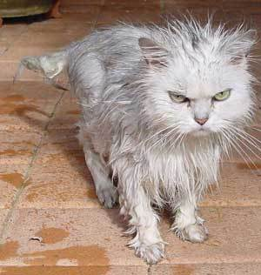
There will be days when you feel like this …

Slide 19
Or this …
But, this too will pass!

Slide 20
POINTS TO REMEMBER
There will be times when you have to make stepping stones out of stumbling blocks.

Slide 21
POINTS TO REMEMBER
What lies behind us and what lies before us are tiny matters compared to what lies within us.
Ralph Waldo Emerson

Slide 22
POINTS TO REMEMBER
Even though you will graduate from medical school, you will still be a life-long student.
S. Douglas, M36

Slide 23
Feedback

Slide 24
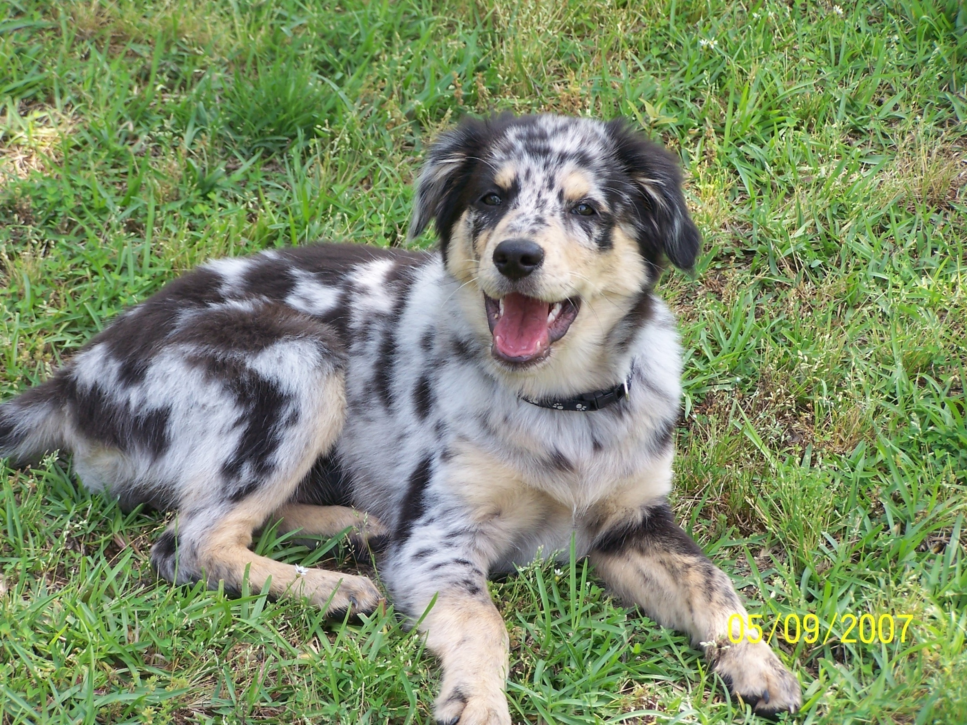
Thank You!
Enjoy the rest of your senior year!

