Slide 1
Choosing a Specialty During a Pandemic (and Beyond)
By Drs. Jeni Tipnis and Richard (Dick) Wardrop

Slide 2
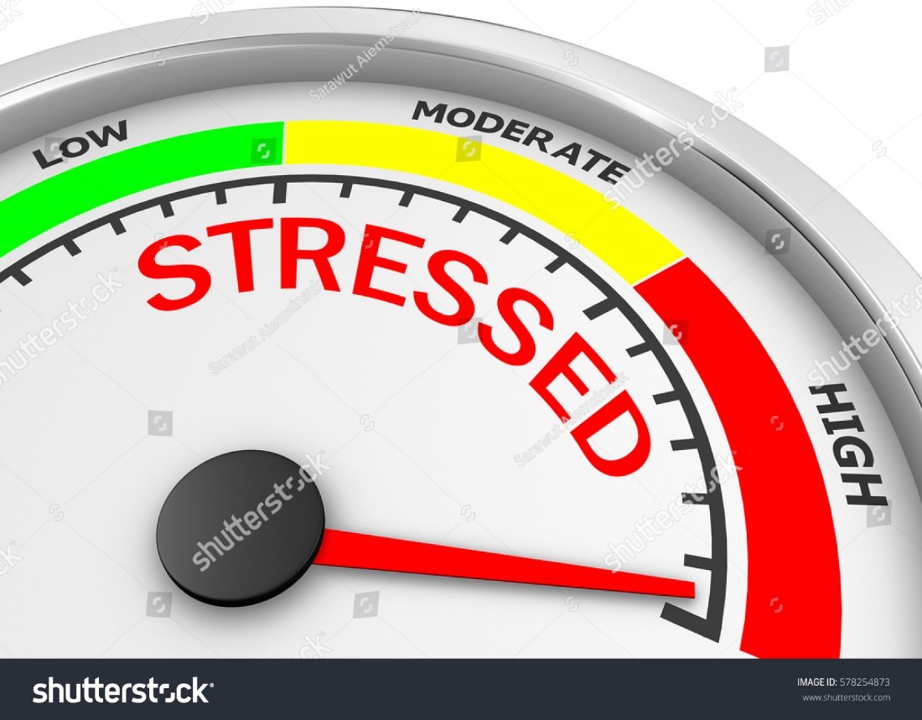
Class of 2021
Objectives of Session
Provide support and guidance towards career choice
Highlight important aspects of career development in regard to advising, mentoring, coaching, sponsorship
Make you more comfortable with reaching out and seeking guidance
Notes:
Delay’s in Step
Telehealth
Lack of the last clerkship
Away Rotations likely cancelled

Slide 3
It’s OK! Congratulations! Enjoy the moment!

Slide 4
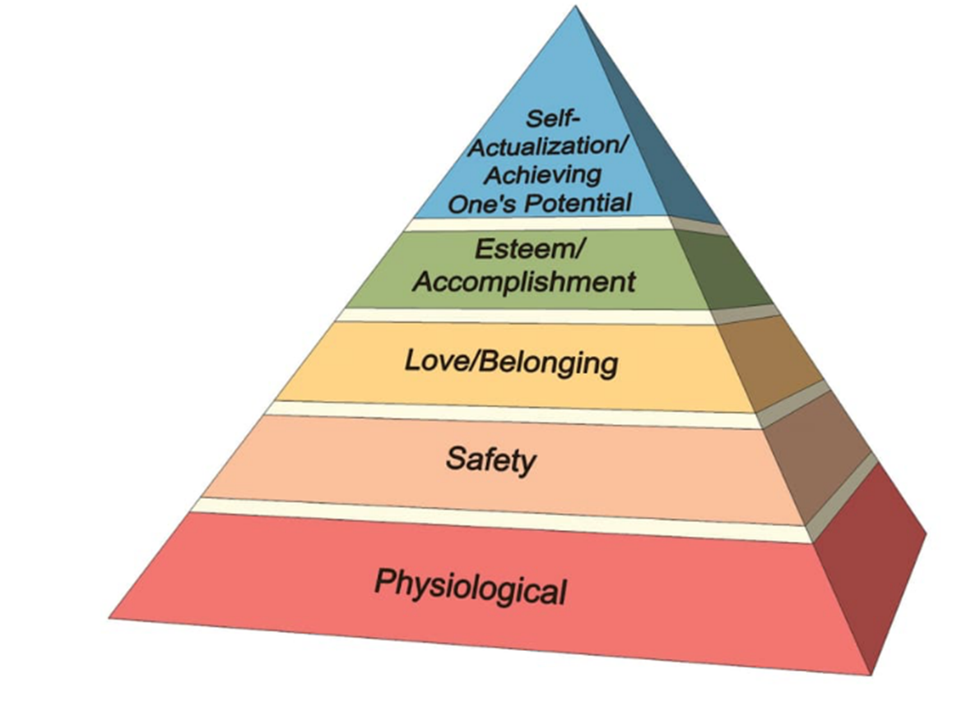
Assumptions Going Forward
You are here!

Slide 5
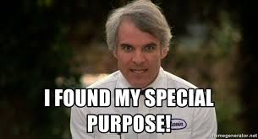
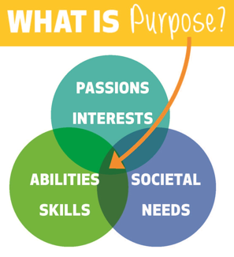
Purpose – a loaded word….we all seek it and need it

Slide 6
Declare specialty choice(s)
1st 4 months
2nd 4 months
Last 4 months

Slide 7
Our Leaders can’t predict the future
Notes:
“The only thing we can honestly say right now, because the situation is so fluid, is that students have to have some trust in the dedication of their faculty and administration and organizations such as the accrediting bodies and licensing boards,” said Kimberly Lomis, MD, the AMA’s vice president for undergraduate medical education innovations
The LCME is providing guidance- we are not alone
The USMLE program recognizes that the testing shutdown has created great stress, uncertainty, and disruption for examinees and medical schools, affecting academic progression, curricular schedules, and application for residency. We are doing everything we can to make decisions that prioritize the safety and health of examinees and test center staff as we develop plans to resume testing. Because of the fluid nature of the COVID-19 outbreak, the ability to make these decisions is slower and more unclear than we would like.

Slide 8
Creativity
LCME has provided guidance
Medical Educators have needed to be creative to accomplishing our schools EPA’s
Much of career guidance to this point for you all has focused on advising
We will also need to consider new strategies for coaching and mentoring students through transitions during this time period and beyond.

Slide 9
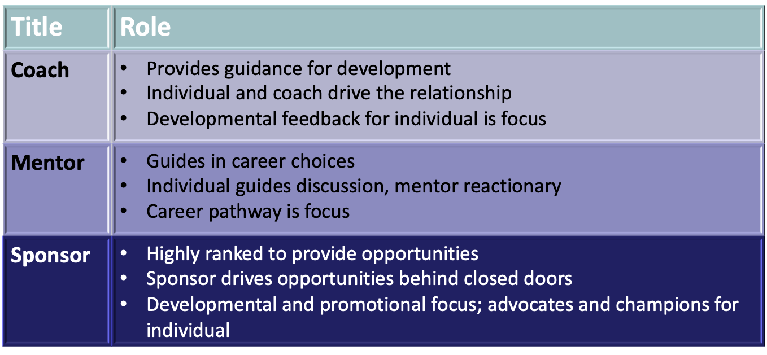
Coaching / Mentoring / Sponsorship “A coach talks with you, a mentor talks to you and a sponsor talks about you.”
Coaches, Mentors, and Sponsors: Understanding the Difference. At the Catalyst: Workplaces that Work for Women, Dec 11, 2017. Available at: http://www.catalyst.org/knowledge/coaches-mentors-and-sponsors-understanding-differences . Last accessed Feb 20, 2018.
Notes:
The types of mentors that can help you through this process

Slide 10
“What’s the deals with……………advising”
Who’s been and advisor?
Did you pick your advisees?
What are the limits of advisors?
Advisees?
Investment of both parties same?

Slide 11
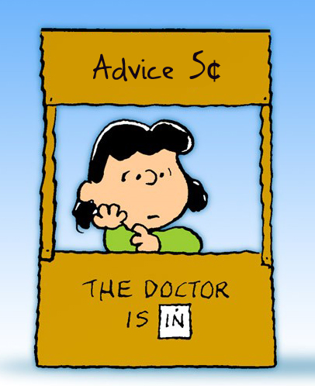
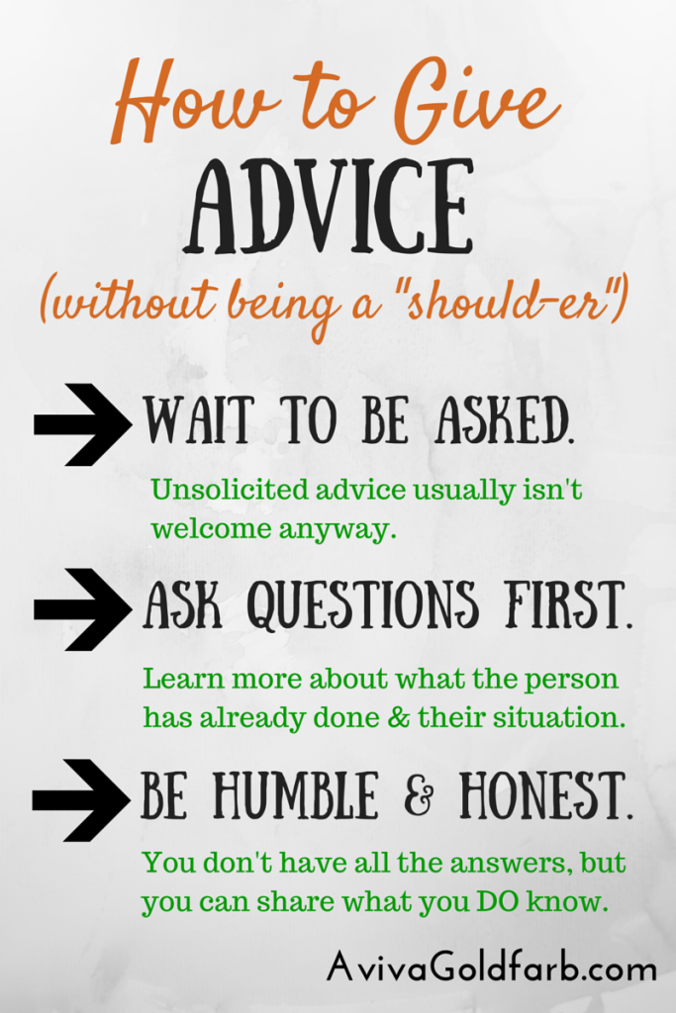
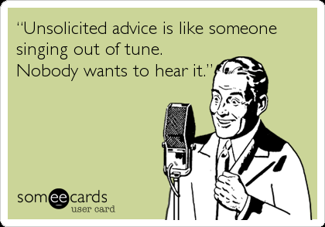
“Advice-ing”

Slide 12
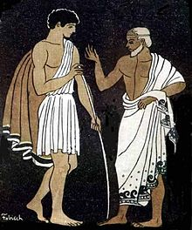
Mentoring
Classic academic practice
Roots in antiquity
Relies on a solid, not trivial relationship
Not Assignable*
“you know it when you see it”

Slide 13
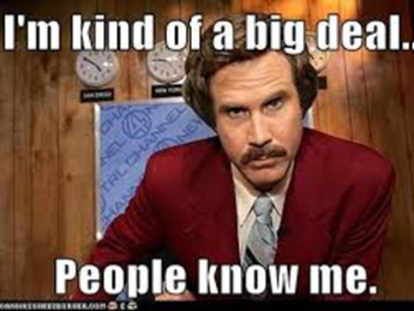
Life as mentor…….
Some common traits
Expertise
Experience
Positive feelings towards mentee
Desire to make mentees be more effective
Many different expectations based on setting
Each situation may have “do’s” and “don’ts” to define relationship
Boss vs not

Slide 14
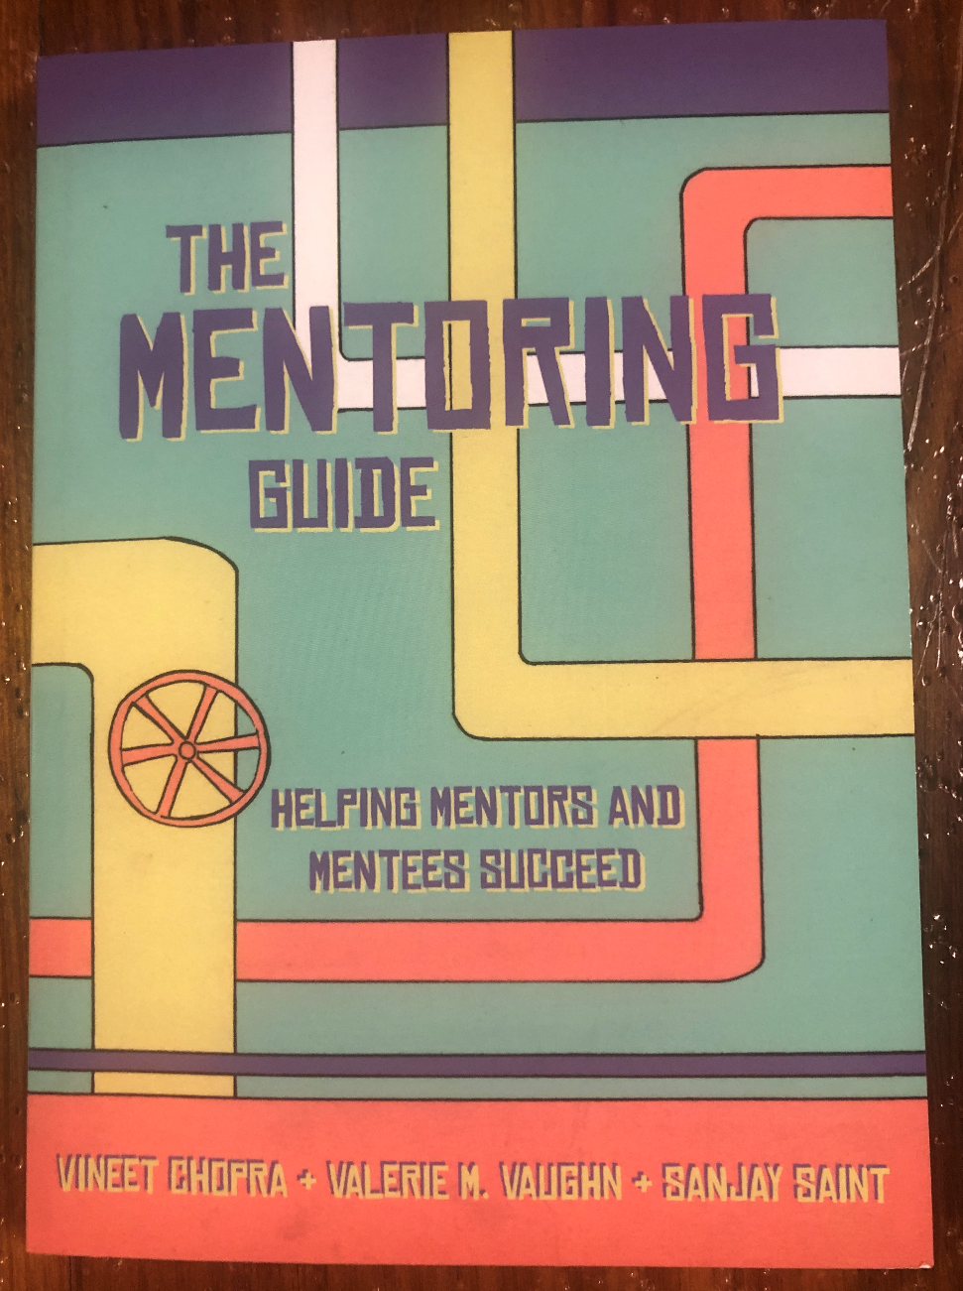
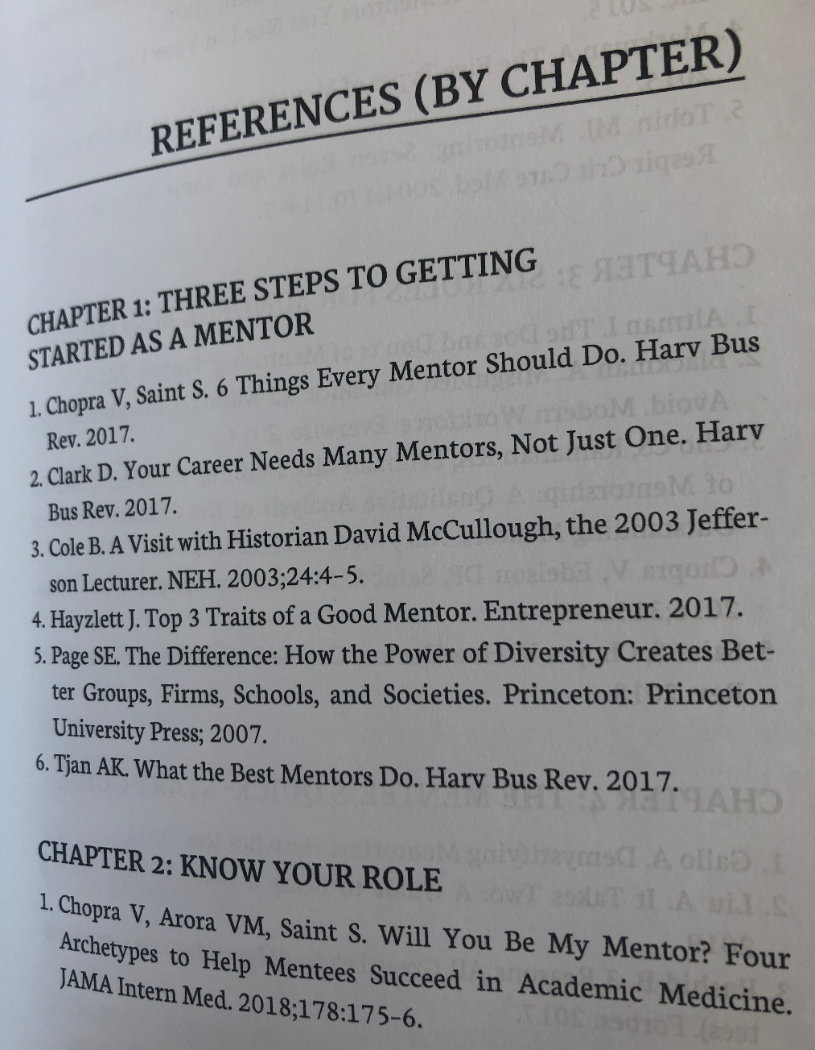
More on Mentoring

Slide 15
Deeper Dive - no “standard Issue”
Traditional Mentor
Mentor invested in long term growth of mentee
Frequent communication and regular meetings
Requires acute attention to detail
Requires considerable investment on both parties
Both thrive on respect and trust
END GOAL and METRIC: Ensure the mentee acquires the skill and knowledge needed to succeed on own.
Chopra V, Arora, VM, Saint S. JAMA IM. 2018; 178:175-6.

Slide 16
Deeper Dive - Coach
Coaches not necessarily invested in the long-term success of the mentee
Coaches help improve performance in one domain or solve one specific issue
Requires less time and effort on both parties
Coaches can coach multiple mentees or groups
Can be a missing link for some mentees who need more specific help
Coaching through USMLE, the SOAP, the match….
Chopra V, Arora, VM, Saint S. JAMA IM. 2018; 178:175-6.

Slide 17
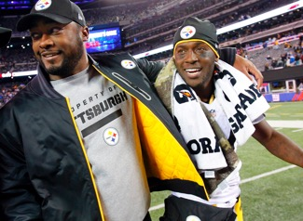
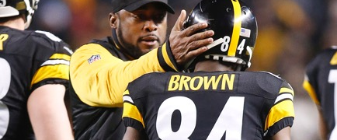
The Greatest Coaching Job in History?

Slide 18
Deeper Dive - Sponsor
Don’t traditionally provide direct advice or guidance
Sponsors use sphere of influence and capital to benefit the mentee
Choose wisely as a sponsor as you advocate for mentees.
Mentees in this setting may not know they are being “sponsored”
Chopra V, Arora, VM, Saint S. JAMA IM. 2018; 178:175-6.

Slide 19
Deeper Dive - Connector
Connectors are hubs that help mentees connect with right coach, sponsor, or mentor.
Usually expert networkers in leadership positions
Can be up or down on the ORG CHART
Connector also help mentors by identifying prospective talent or areas for coaching or areas for sponsorship
Chopra V, Arora, VM, Saint S. JAMA IM. 2018; 178:175-6.

Slide 20
Rules for Mentees
Choose Mentor Wisely – ask
Is this person someone I want to be like?
Trustworthy, integrity?
Their skills align with my goals. Any skills?
Reciprocal feeling / desire to mentor
Prior mentees doing well?
Be Mindful of Mentors Time
Schedule recurrent meetings – run them well
Prepare for meetings with mentor
Bring your thoughts to the table
Tell mentor what to expect

Slide 21
Exemplary Mentees
Begin with honesty and clarity
Keep mentor in the loop
Be open about obstacles
Listen more than you talk
Focus on being professional
Follow through
Lose the “me” mentality
Under promise and over-deliver
Don’t lose sight of your original goals or new goals
Chopra, V., Vaughn, VM, Saint S. The Mentoring Guide. 2019. Michigan Publishing

Slide 22
Guiding you through the process
The Office of Medical Education team
The Deans
Robyn Herring
Lucy Varela-Quintero
Stephanie McLaughlin
Jerry Clark
Sharon Douglas
David Norris
Jeni Tipnis
Lyssa Weatherly
Loretta Jackson-Williams

Slide 23
Guiding you through the process
Medicine, Med-Peds, preliminary years
Dr. Richard Wardrop (Chair's letter and advising)
Dr. Michelle Horn
Dr. Calvin Thigpen (PD)
Dr. Zeb Henson (MP PD)
Chief residents
Family Medicine-
Dr. Shree Melton
Dr. David Norris
Neurology and PM&R
Amanda Witt
OB
Dr. Elizabeth Lutz
Psychiatry
Dr. Joy Houston
Pediatrics
Dr. Kim Paduda
Dr. Austin Harrison
virtual faculty

Slide 24
Guiding you through the process-Surgery
For General Surgery:
Dr. Mark Earl
Dr. Felicitas Koller
Dr. Matt Kutcher
Dr. Jon Carrol
Dr. Michael Morris
Dr. Shannon Orr
Dr. Praise Matemavi
Dr. Chinenye Iwuchukwu
Renee Greene is a good initial contact in terms of reviewing an application
ENT
Dr. Lana Jackson
Dr. Gina Jefferson
Dr. Jeff Carron
Orthopedics
Dr. Matt Graves
Dr. Patrick Bergin
Dr. Jennifer Barr
Dr. Jaysson Brooks
Neurosurgery
Dr. Chad Washington

Slide 25
Guiding you through the process
Plastic Surgery Direct Route
Dr. Ben McIntyre
Dr. Jared Davis
Urology
Dr. Chris Bean
Dr. Charlie Pound
Anesthesia
Dr. Bryan Heirlmeier
Dr. Anad Prem
Dr. Sara Robertson
Dr. Shae Bell
Dr. LaToya Mason
Dr. John Adams
Dr. Kirk Reid
Dr. Doug Bacon

Slide 26
Guiding you through the process
Many Faculty at the department level will help
Consider a voluntary rotation after students are cleared to return to the hospital
Use the voluntary mentor list
If you need a mentor connector contact Dr. Tipnis
Dr. Wardrop also happy to provide general “non-Dean” career goal advising.

Slide 27
We are not alone

Slide 29
What has the pandemic taught us?
Self directed learning
Learning in a new situation is an iterative process
As medical providers the learning never ends…
Notes:
Before a few months ago no one knew anything about COVID 19
We all have had to learn
Sometimes we were wrong ARDS vs altitude sickness

Slide 30
How to be a self directed learner?
Notes:
Please reach out if there are resources you need to accomplish your goals

Slide 31
Passion and Life Long Learning!

